Slide 1
CSE422: Artificial intelligence
Naïve-Bayes Classifier
Asif Shahriar
Lecturer, CSE, BRACU

Slide 2
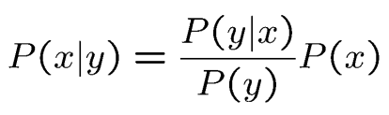
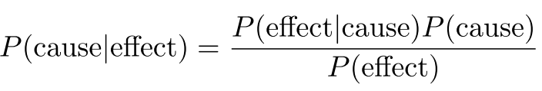
BAYES’ Rule
From the formula of conditional probability P(x ∣ y) = P(x, y) / P(y), we can infer: P(x, y) = P (x | y) × P(y) [called the product rule]
Similarly, P(x, y) = P (y | x) × P(x)
Dividing we get:
In other words:
Why is this SO important?
It is hard to know the cause, but it is easy to see the effect
Using this formula, we can infer the cause by analyzing the effect

Slide 3
BAYES’ Rule
Likelihood
Class-prior probability
Posterior probability
Predictor-prior probability

Slide 4
BAYES’ Rule
Temperature (F) | Play Tennis
70 | Yes
32 | No
65 | No
75 | Yes
30 | No
75 | Yes
72 | No
Consider two boolean RVs, A: “We will play tennis” and B: “Warm day (Temp >= 50 F)”
Think ML: Temperature is “feature”, Play tennis is “target”
If it is a warm day, what is the probability that we will play tennis?
Think ML: Given a feature, predict the target

Slide 5
BAYES’ Rule
Temperature (F) | Play Tennis
70 | Yes
32 | No
65 | No
75 | Yes
30 | No
75 | Yes
72 | No
If it is a warm day, what is the probability that we will play tennis?
P(b | a) = 1
P(a) = 3/7
P(b) = 5/7
Therefore, P(a | b) = 0.6
Think ML: Output = YES

Slide 6
Why BAYES is DIFFICULT in Practice
Wind | Humidity | Temperature | Play Tennis
5 | 95 | 70 | Yes
10 | 80 | 32 | No
20 | 80 | 65 | No
10 | 85 | 75 | Yes
8 | 35 | 30 | No
8 | 35 | 75 | Yes
25 | 35 | 72 | No
Now let there are FOUR boolean RVs: A (“Play tennis”), B(“Warm day”), C(“Dry day”), D(“Windy day”) [Think ML: Features: B, C, D, Target: A]
We want to find the probability of playing tennis in a warm, dry, windy day P(a | b, c, d)
For this we need the likelihood P(b, c, d | a)
Computing this is REALLY difficult and makes it hard to use BAYES in real applications
For this problem it is actually easy (do it)
But this is a small table with 7 entries only
In real world, to compute such a likelihood with good accuracy would require an extensive record with millions of entries – very expensive and difficult

Slide 7
Naïve-Bayes Classifier
Computing the likelihood P(b, c, d | a) is difficult in real world applications
However, we can APPROXIMATE the calculation, making it practical for real use
The Naïve assumption: All features are conditionally independent of each other given the target label
In other words, B, C, D are conditionally independent given A
So, using our formula for conditional independence, we get:
P(b, c, d | a) = P(b | a) × P(c | a) × P(d | a)
This is much easier to calculate from records!
The Naïve Bayes classifier often does surprisingly well, outperforming more sophisticated classification methods
P(X1, X2,⋅⋅⋅, Xn |C) = P(X1 |C)P(X2 |C) ⋅⋅⋅ P(Xn |C)

Slide 8
Approximation using Naïve-BAYES
Wind | Humidity | Temperature | Play Tennis
5 | 95 | 70 | Yes
10 | 80 | 32 | No
20 | 80 | 65 | No
10 | 85 | 75 | Yes
8 | 35 | 30 | No
8 | 35 | 75 | Yes
25 | 35 | 72 | No
We want to find the probability of playing tennis in a warm, dry, windy day P(a | b, c, d)
P(a | b, c, d) = P(b, c, d | a) × P (a) / P(b, c, d)
Do it yourself!

Slide 9
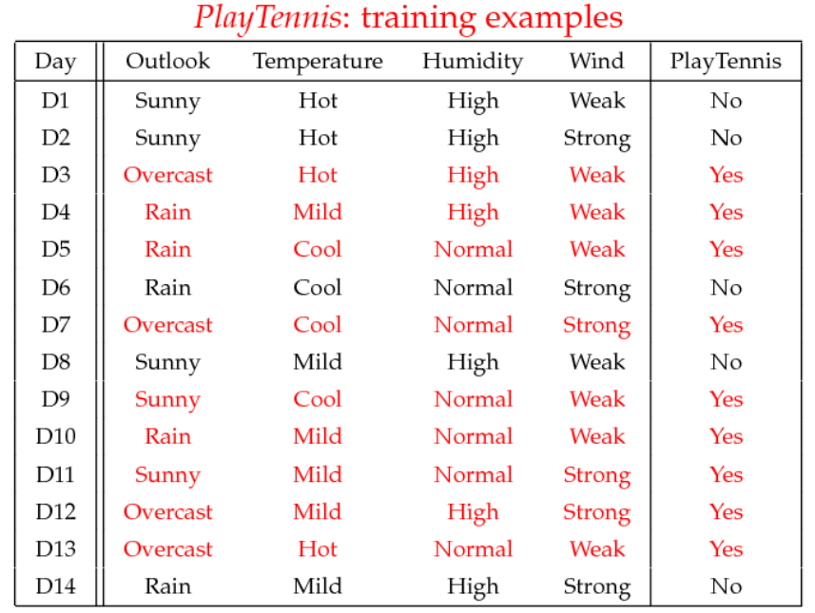
Naïve-BAYES Example
Step 1 – Learning: From the training data, we will LEARN the conditional probability distribution of each Feature (Outlook, Temperature, Humidity, Wind) Given the Target (PlayTennis)

Slide 10
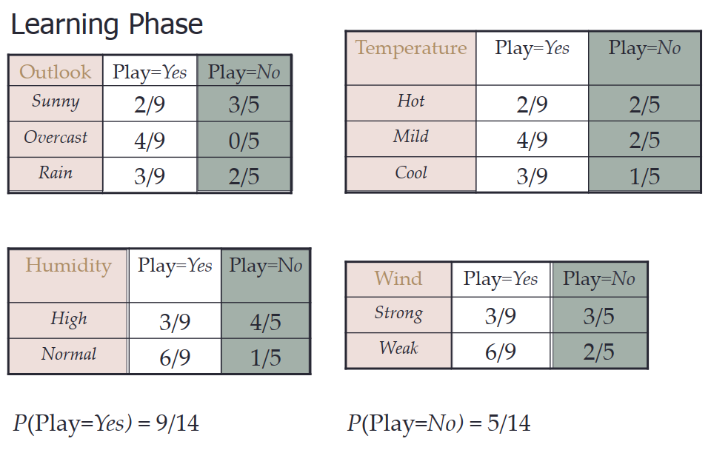
Naïve-BAYES Example
Caution: This is a CONDITIONAL probability table, NOT Joint Probability Distribution Table like toothache, cavity tables

Slide 11
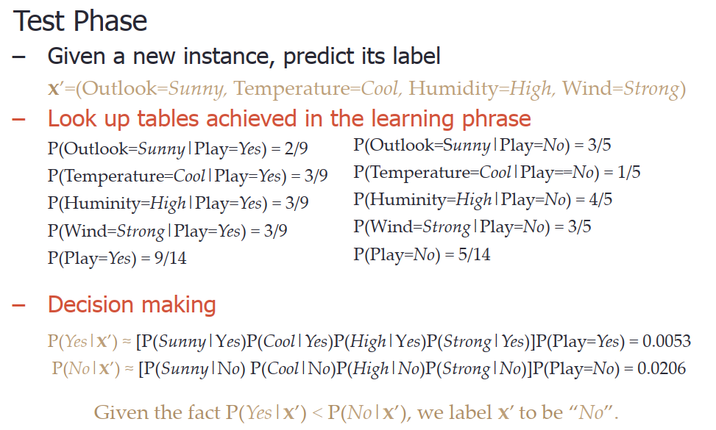
Naïve-BAYES Example
Step 2 – Testing: Using what we learned (likelihoods) during training, we will PREDICT the label (target) for a new, unseen input data

Slide 12
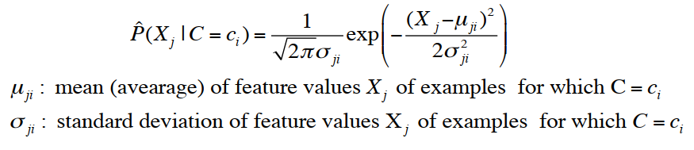
Naïve-BAYES for Continuous-valued Features
Features are not always discrete, sometimes they are continuous
Example: Temperature is a naturally continuous RV
Yes: 25.2, 19.3, 18.5, 21.7, 20.1, 24.3, 22.8, 23.1, 19.8
No: 27.3, 30.1, 17.4, 29.5, 15.1
Problem: Very unlikely that we will find an exact value of temperature
E.g. P(Play = YES | Temp = 25.8), but Temp = 25.8 DOES NOT EXIST in data
Solution: Model continuous probabilities with Normal Distribution

Slide 13
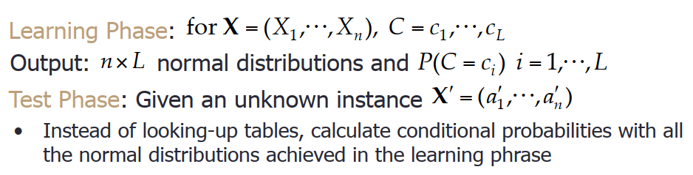
Naïve-BAYES for Continuous-valued Features

Slide 14
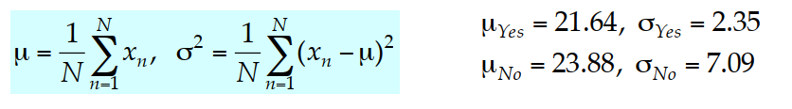
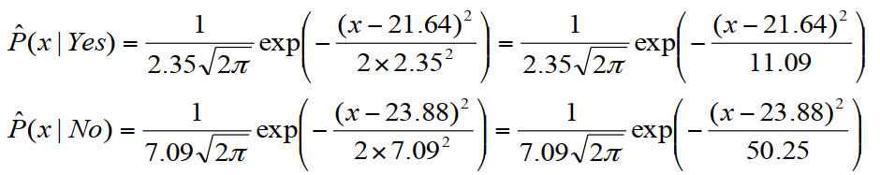
Naïve-BAYES for Continuous-valued Features
Let’s consider the temperature example again
Yes: 25.2, 19.3, 18.5, 21.7, 20.1, 24.3, 22.8, 23.1, 19.8
No: 27.3, 30.1, 17.4, 29.5, 15.1
Estimate mean and variance for each class
Learning Phase: output two Gaussian models for P(temp|C)

Slide 15
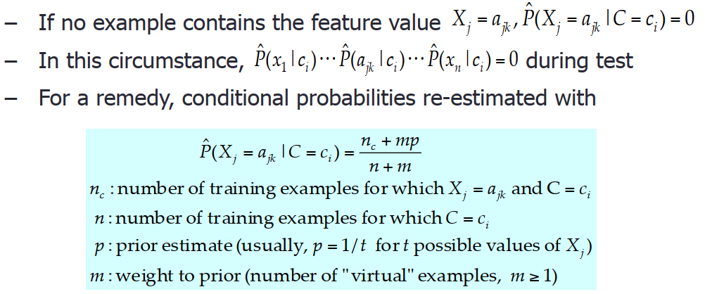
Relevant Issues to consider for Naïve-BAYES
Violation of Independence Assumption
For most real worlds tasks, P(X1,⋅⋅⋅,Xn|C) ≠ P(X1|C)⋅⋅⋅ P(Xn|C) [i.e. features are not independent]
Nonetheless, Naïve-BAYES works surprisingly well anyway
Check this out for a comparison against other models: notebook
Zero conditional probability Problem

